Slide 1

Image Recognition using Neural Networks
Aerospace Engineering
Authors: Yi Qiang Ji Zhang
Professor/s:
Alex Ferrer Ferré

Slide 2
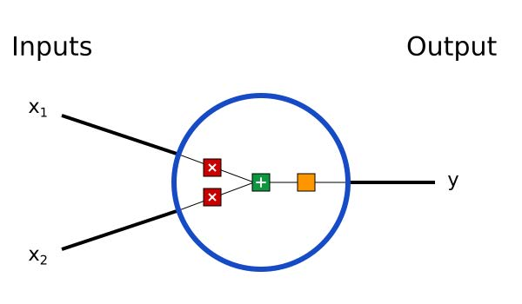
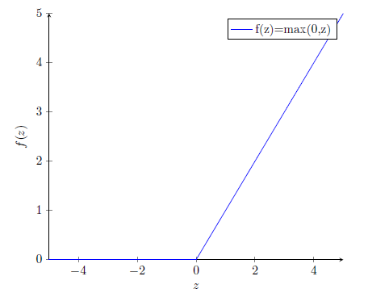
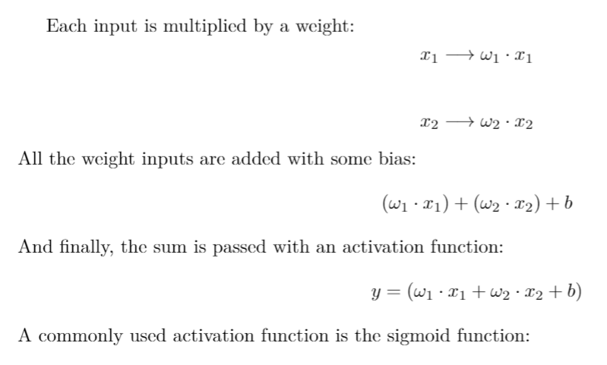
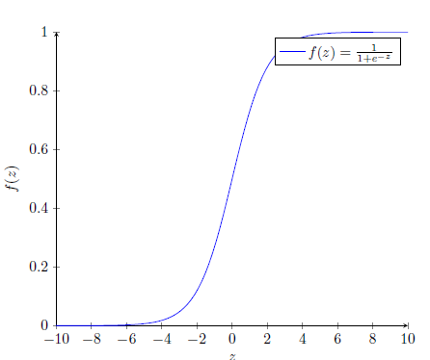
Introduction
Neural Networks
A neuron is the basic unit of the neural network. It takes inputs parameters, then does some computation with them, and produces one output.
Neuron scheme [1]
ReLU function
[1] https://www.researchgate.net/figure/A-Basic-sigmoid-function-with-two-parameters-c1-and-c2-as-commonly-used-for-subitizing_fig2_325868989
Sigmoid function

Slide 3
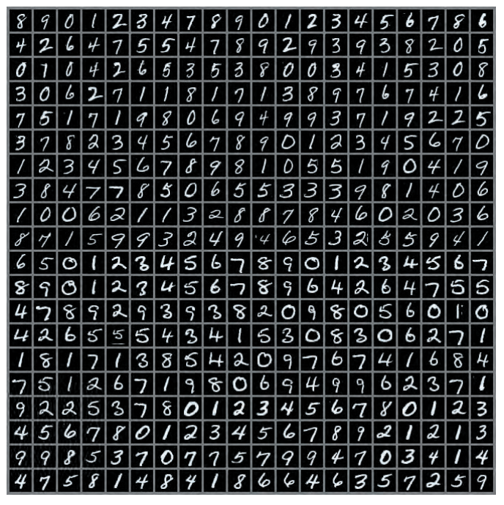
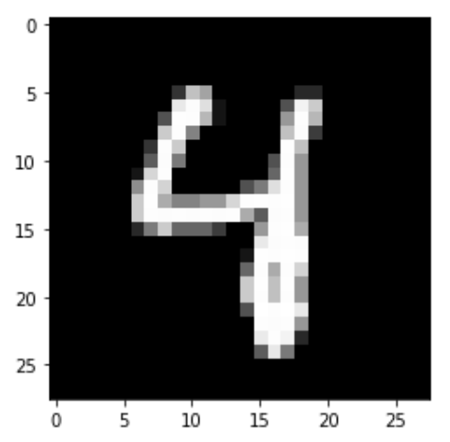
Problem statement
The dataset we're using is the well-known MNIST handwritten digit dataset, which is frequently used in both ML and computer vision applications. It includes 28 × 28 grayscale photos of handwritten numerals that resemble as follows:
MNIST dataset [1] [2]
[1] https://www.researchgate.net/figure/A-Basic-sigmoid-function-with-two-parameters-c1-and-c2-as-commonly-used-for-subitizing_fig2_325868989
[2] https://www.deeplearningbook.org/

Slide 4
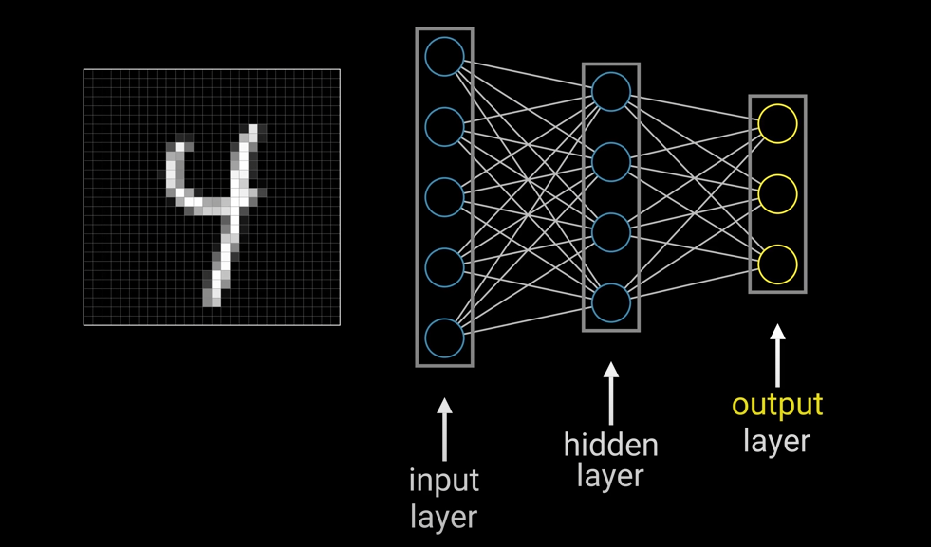
Methodology

Slide 5
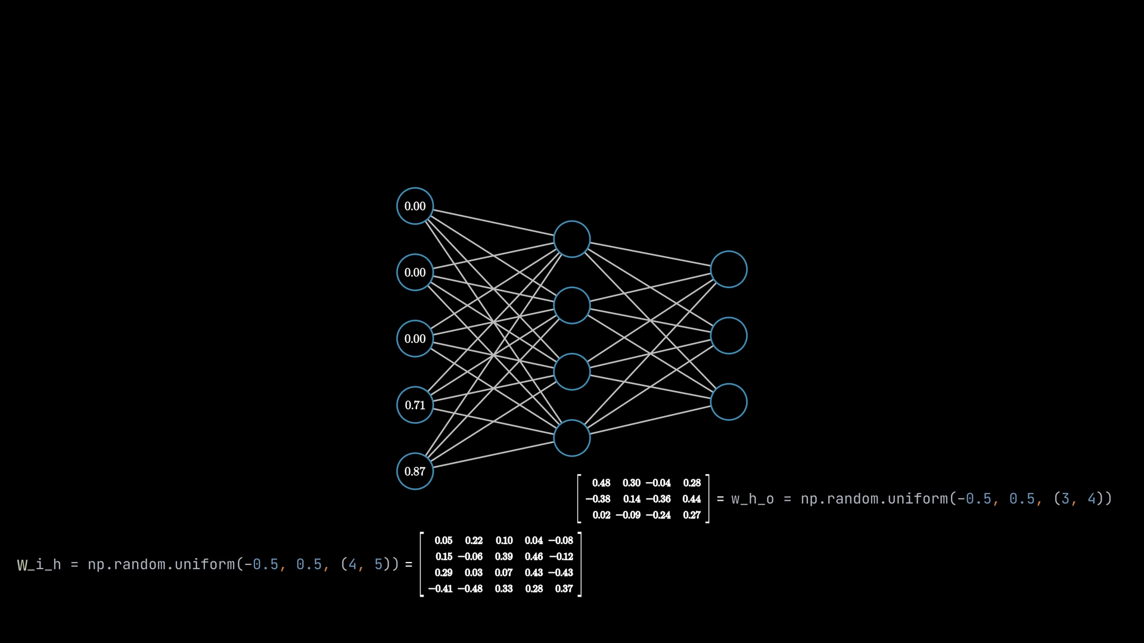
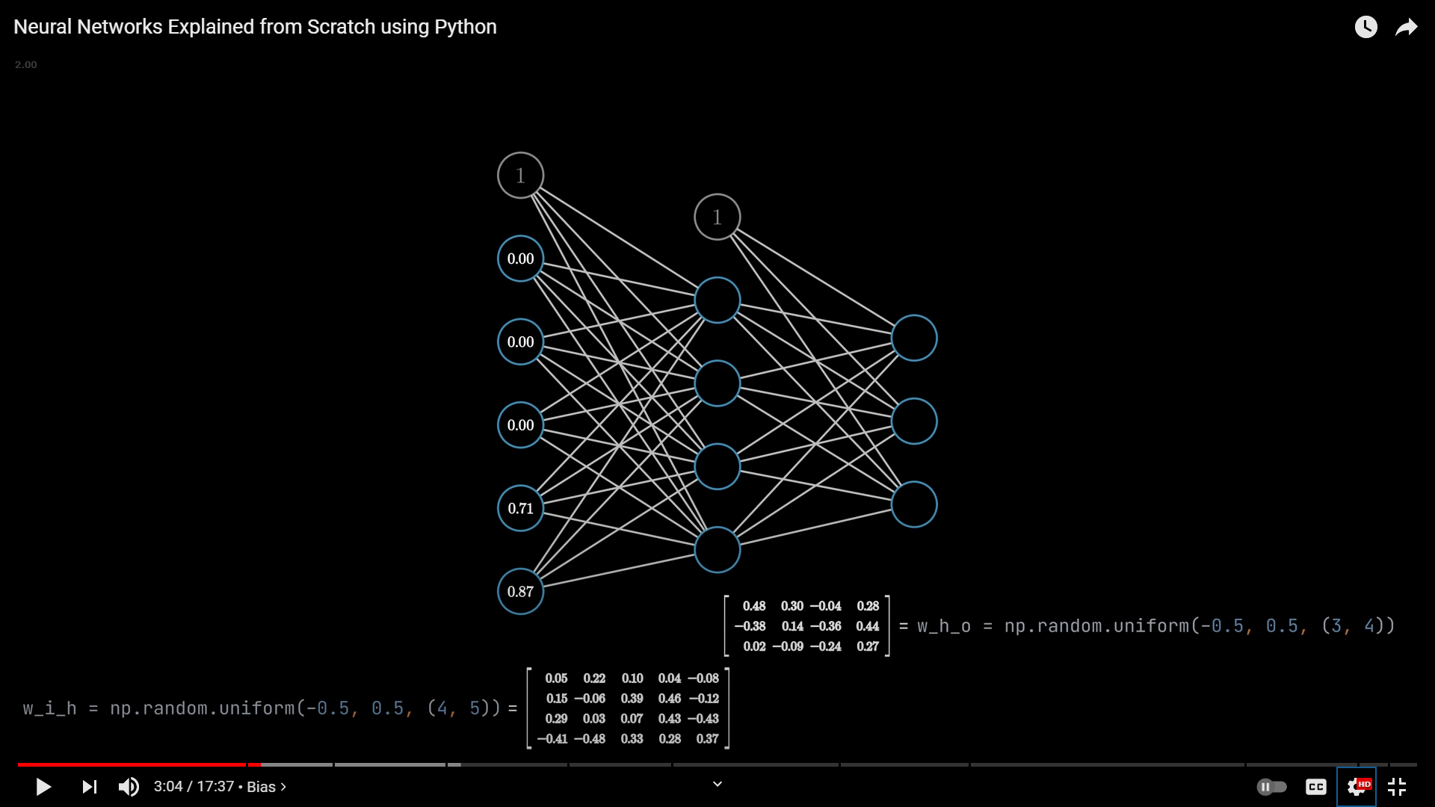
Methodology
Bias (to allow the function to shift) since the weights only change slope

Slide 6
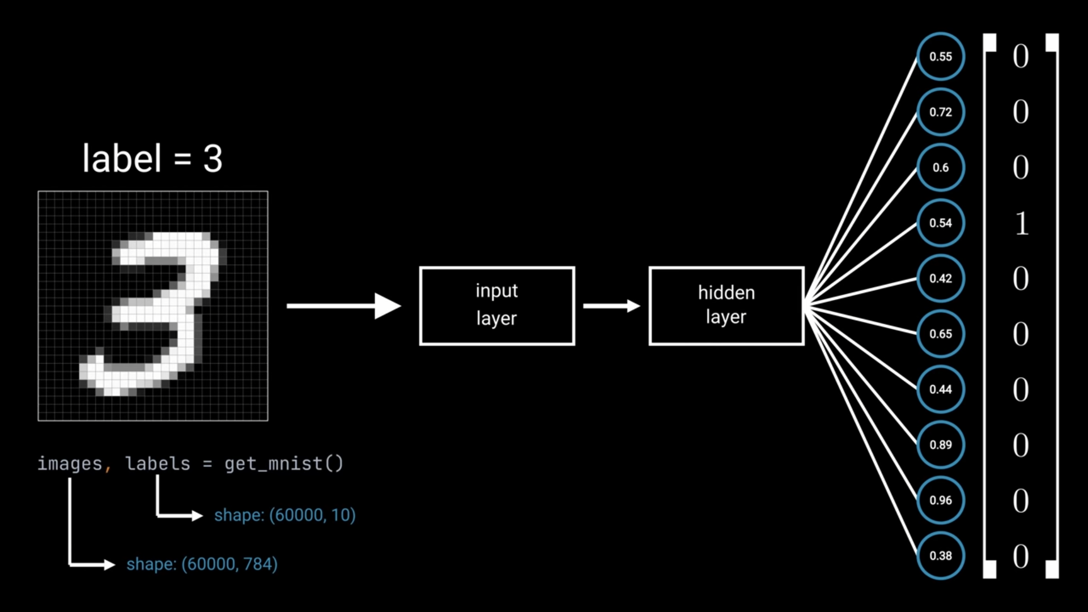
Methodology

Slide 7
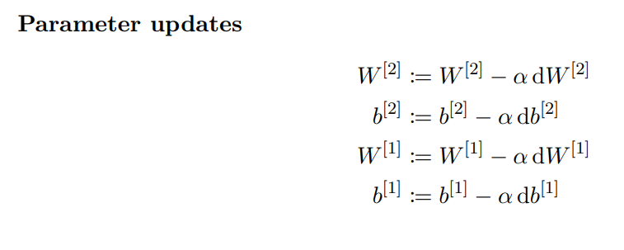
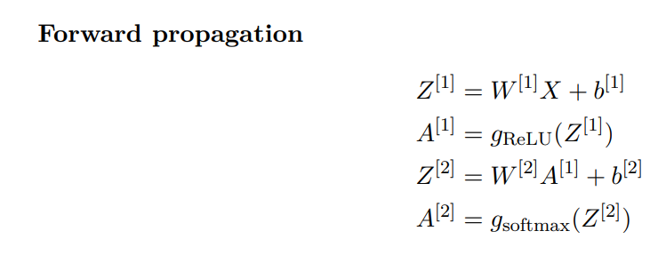
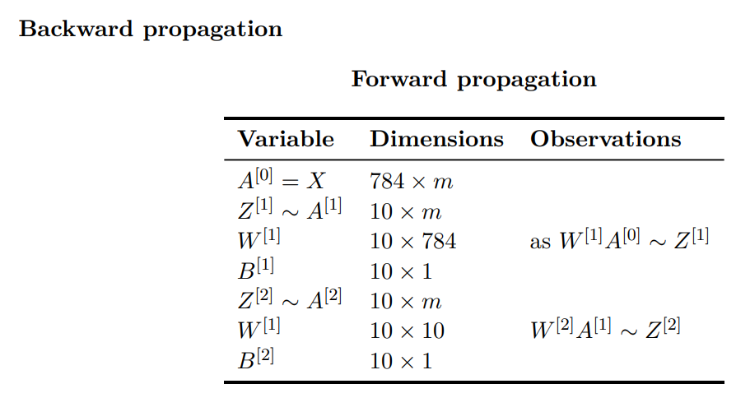
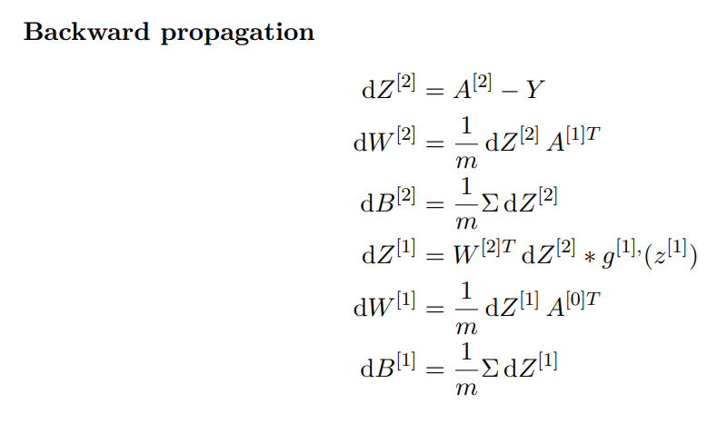
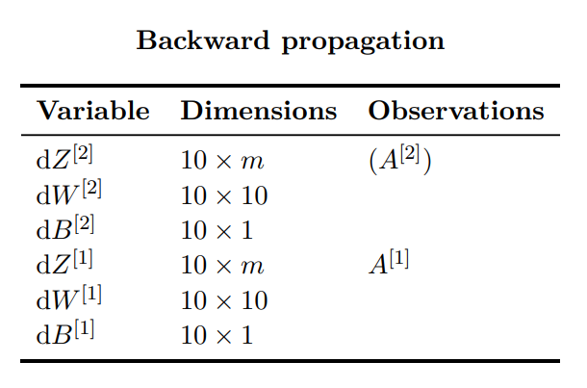
Methodology

Slide 8
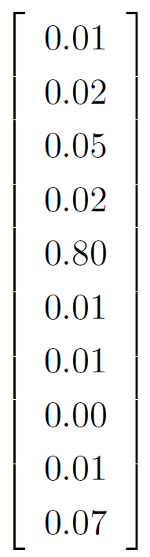
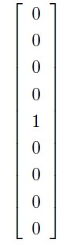
Methodology (cont.)
One Hot encoder

Slide 9
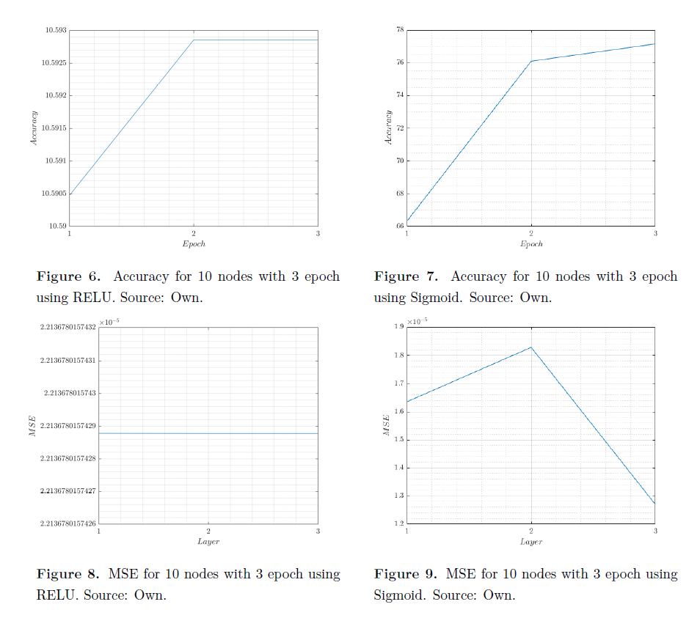
Results
1 layer
3 Epoch

Slide 10
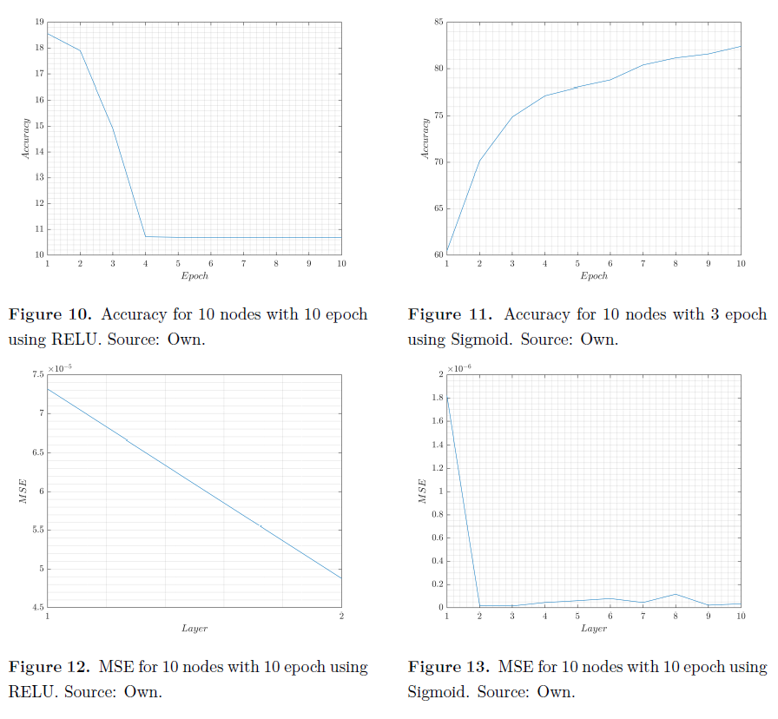
Results
1 layer
10 Epoch

Slide 11
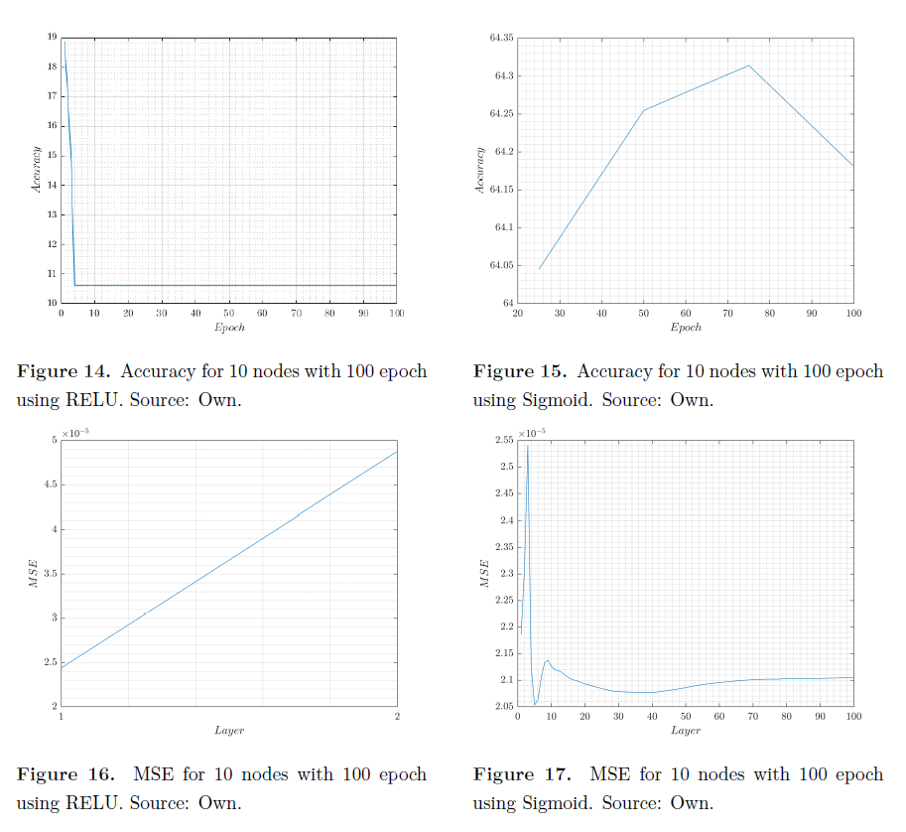
Results
1 layer
100 Epoch

Slide 12
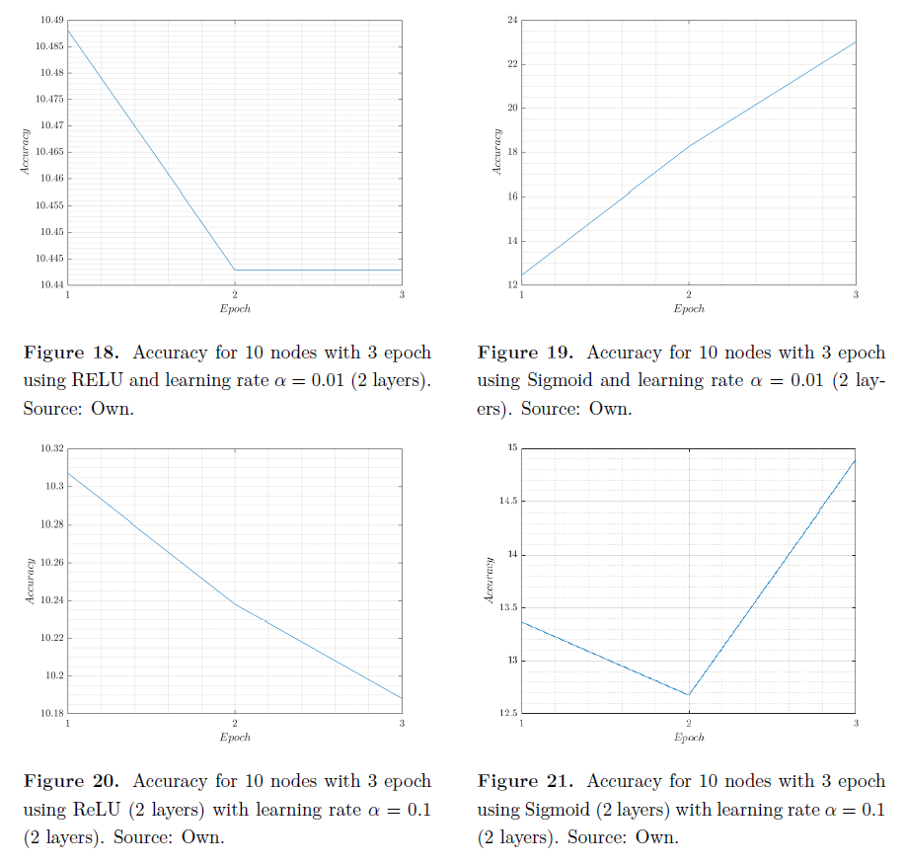
Results
2 layers
3 Epoch

Slide 13
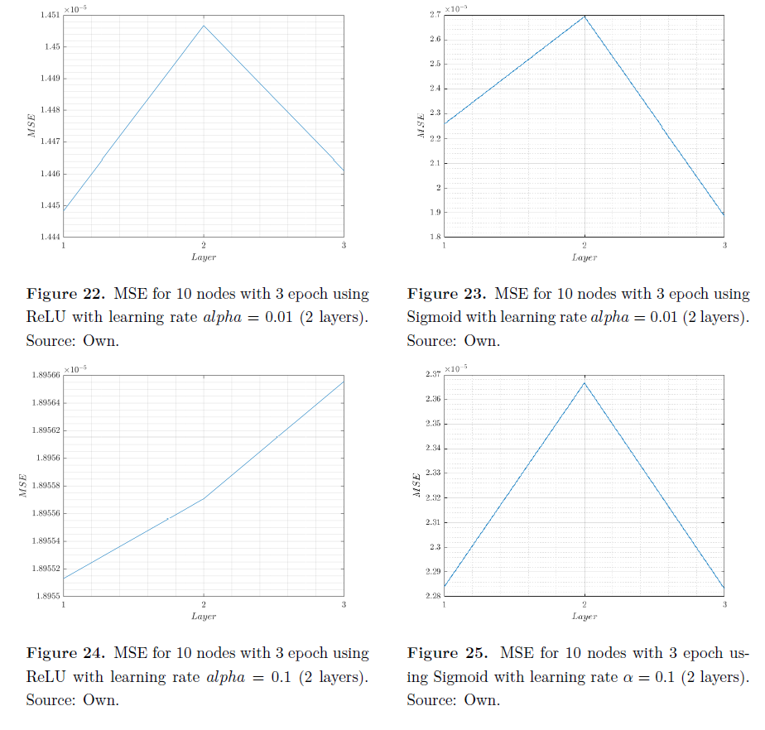
Results
2 layers
3 Epoch

Slide 14
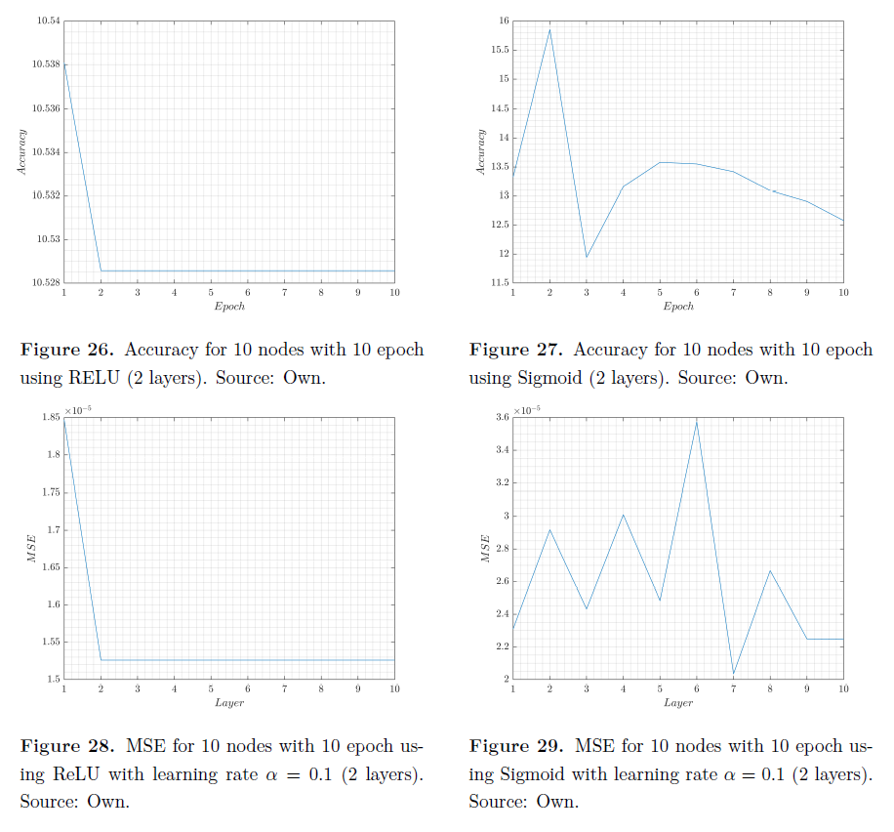
Results
2 layers
10 Epoch

Slide 15
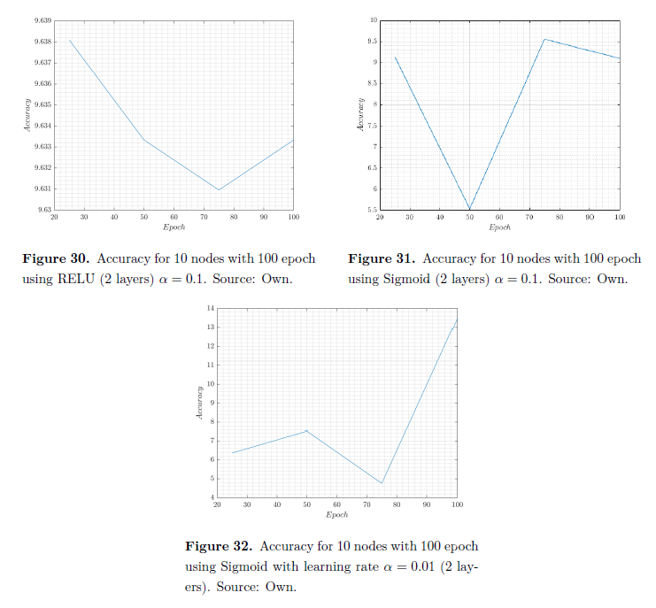
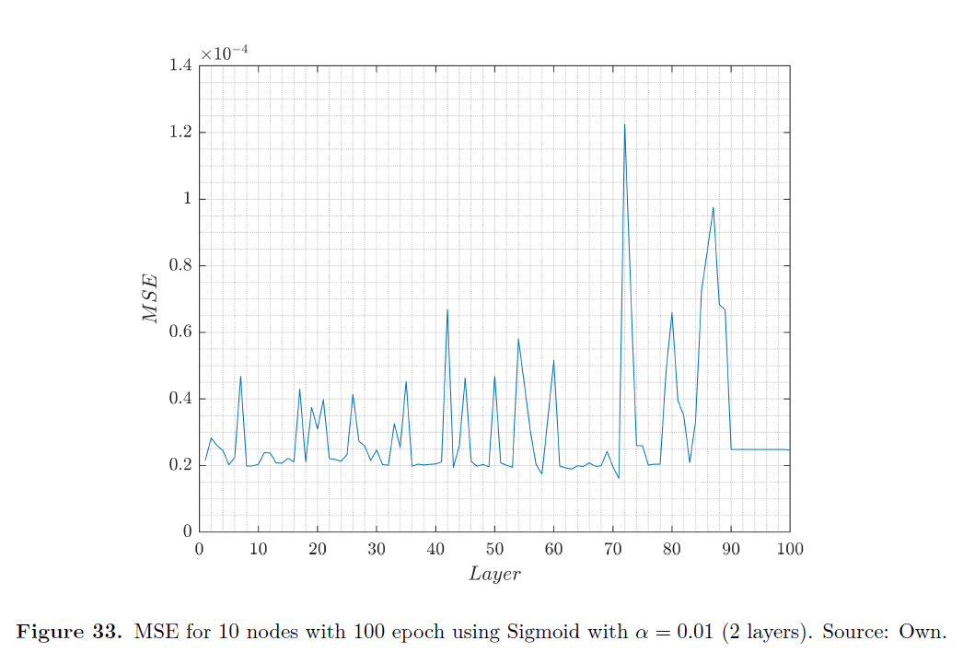
Results
2 layers
100 Epoch

Slide 16
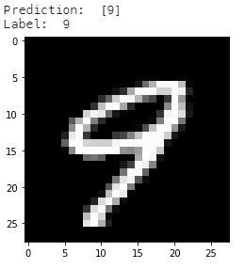
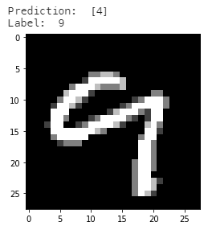
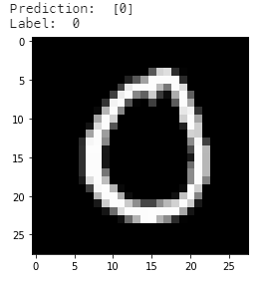
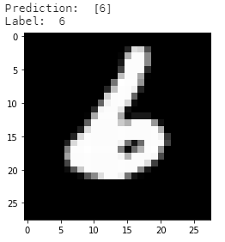
Testing the algorithm image
Accuracy achieved: 88.1% with 1000 iterations (single layer)
[1] Lauterborn W.(2003) Chaotic Systems. https://www.sciencedirect.com/topics/computer-science/chaotic-systems
Notes:
https://www.sciencedirect.com/topics/computer-science/chaotic-systems

Slide 17

Further improvements and questions
How to implement a Convolutional Neural Network?
Convolutional Neural Network [1]
[1] https://dev.to/afrozchakure/cnn-in-a-brief-27gg
Notes:
https://www.sciencedirect.com/topics/computer-science/chaotic-systems

Slide 18
Further improvements and questions (cont.)
Why ReLU activation function does not increase accuracy?
Potential explanation: when using an input in [0, 255], then when doing the weighted sum for the layer L: z=a(L−1)w(L)+b(L), the value z will often be big too. If z is often big (or even if it's often > 0), let's say around 100, than ReLU(z)=z, and we totally lose the "non-linear" aspect of this activation function! Said in another way: if the input is in [0, 255], then z is often far from 0, and we totally avoid the place where "interesting non-linear things" are going on (around 0 the ReLU function is non linear and looks like __/)... Now when the input is in [0,1], then the weighted sum z can often be close to 0: maybe it sometimes goes below 0 (since the weights are randomly-initialized on [-1, 1], it's possible!), sometimes higher than 0, etc. Then more neuron activation/deactivation is happening... This could be a potential explanation of why it works better with input in [0, 1].
[1] https://datascience.stackexchange.com/questions/18667/relu-vs-sigmoid-in-mnist-example
Notes:
https://www.sciencedirect.com/topics/computer-science/chaotic-systems

Slide 19
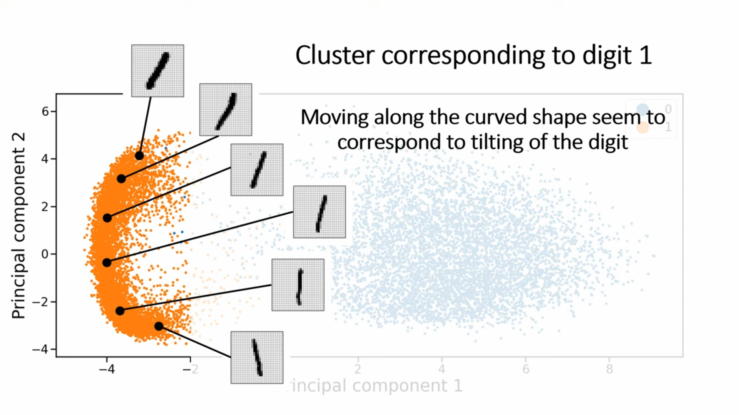
PCA
https://gitlab.com/erikfransson/pca-mnist-testing
Notes:
https://www.sciencedirect.com/topics/computer-science/chaotic-systems

Slide 20
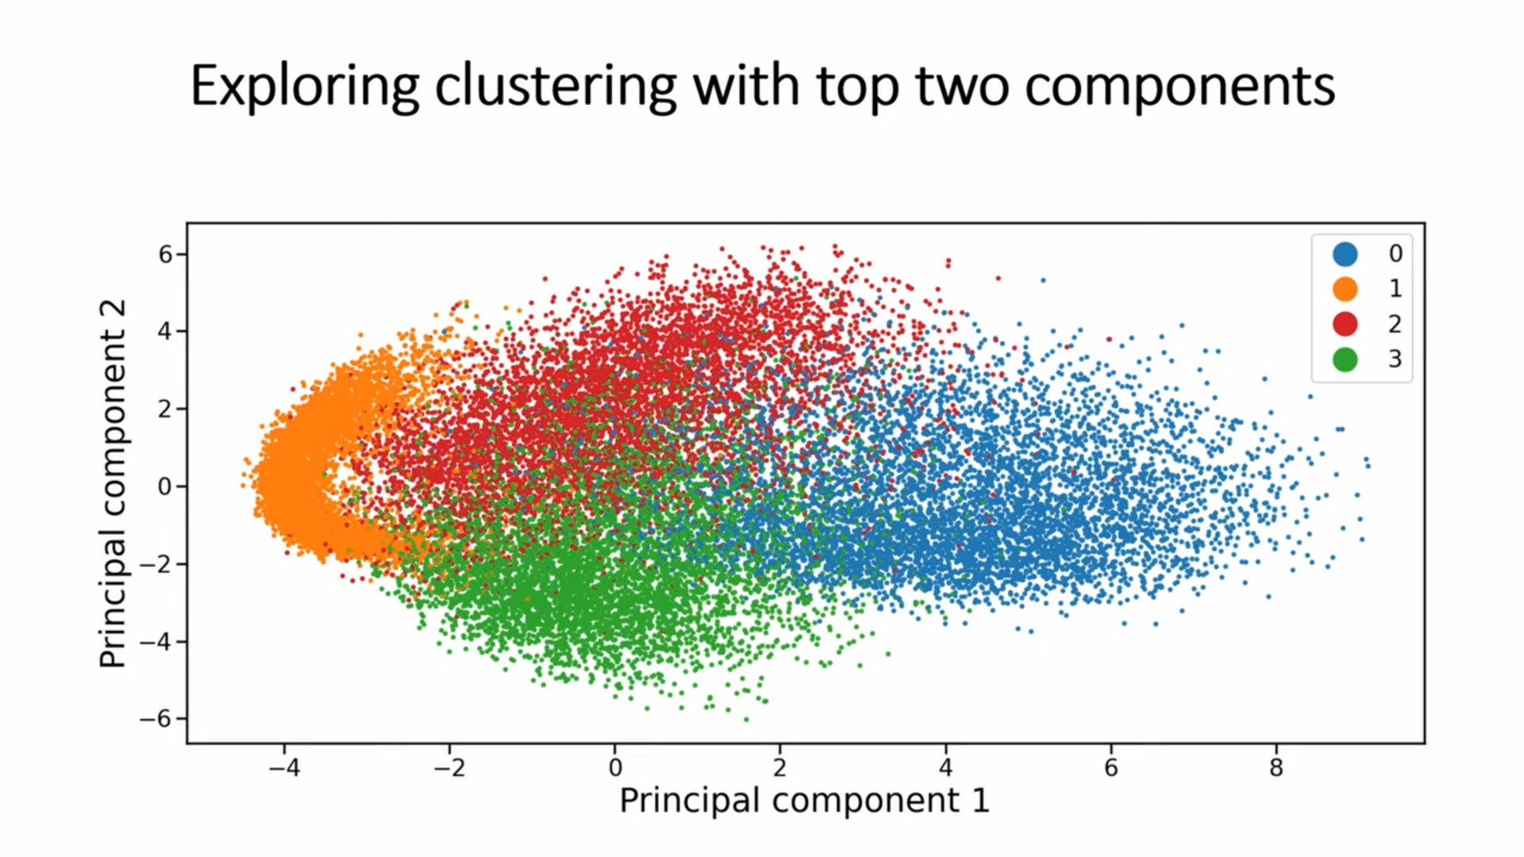
PCA
Notes:
https://www.sciencedirect.com/topics/computer-science/chaotic-systems

Slide 21
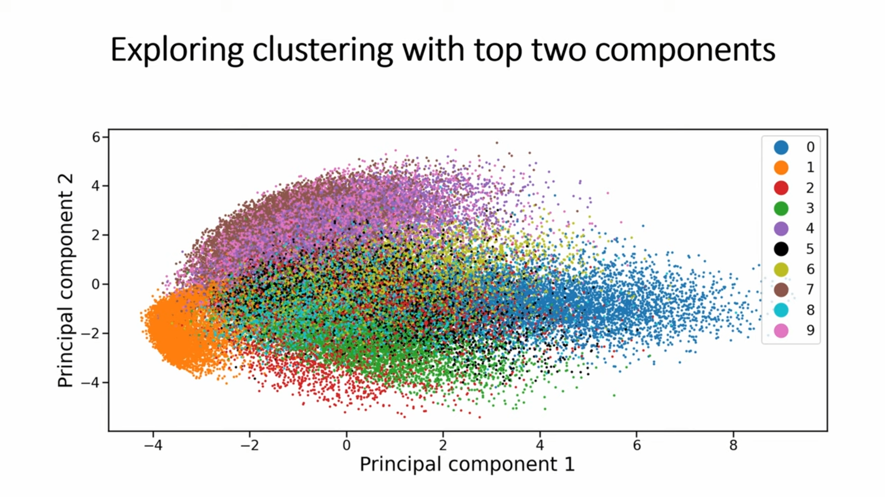
PCA
Notes:
https://www.sciencedirect.com/topics/computer-science/chaotic-systems

Slide 22
3D visualization
https://www.youtube.com/watch?v=3JQ3hYko51Y

